Slide 1

The origins of modern-day positive psychology
“Psychology is much larger than curing mental illness or curing diseases. I think it’s about bringing out the best in people; it’s about positive institutions; it’s about strength of character.”
– Martin Seligman

Slide 2
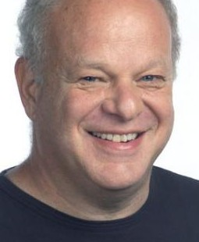
Definition
According to Martin Seligman– who is seen as the founding father of positive psychology– the positive psychology movement can be described as:
“The study of what constitutes the pleasant life, the engaged life, and the meaningful life.”

Slide 3
The personal stories behind the movement
Martin Seligman is considered the father of positive psychology.
He tells the story of a central moment during 1998, a few months before he was elected president of the American Psychological Association.

Slide 4

“I was weeding the garden with my 5 year old daughter Nikki. She was throwing weeds, singing and dancing while I was actually trying to get the weeding done. I yelled at her, she walked away, then came back and said:

Slide 5
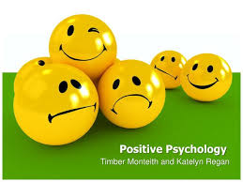
Daddy, do you remember, before my 5th birthday? I was a whiner (complainer). I whined everyday. When I turned 5 I decided not to whine anymore. That was the hardest thing I’ve ever done. And if I can stop whining, you can stop being such a grouch.”

Slide 6
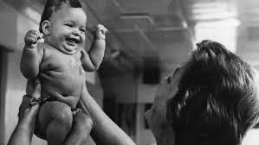
He realized that raising children is not about fixing and correcting what’s wrong with them. But identifying and enhancing their strongest qualities and what they do best.

Slide 7

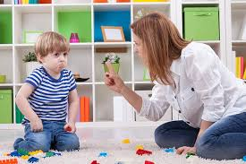
Helping them find the environments that allow them to play out their strengths and live productive, fulfilled lives.

Slide 8

Arat Hosseini
Notes:
https://www.youtube.com/watch?v=7gum8PK9rpI

Slide 9
Mohammad Hosseini accidentally found his 3-months-child has powerful hands and can hang easily from different points.
Mr Hosseini became sure about Arat’s ability in doing Gymnastic and Acrobat when he watched his 7-months-child could do a back flip when he is swinging from a horizontal bar.

Slide 10

Later 13-months-old child was able to do consecutive back flips .”I have decided to spend all my time training my son when I realized that he has an astounding talent in doing Gymnastic and Acrobat” Mr Hosseini said.

Slide 11
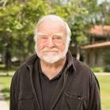
Mihaly Csikszentmihalyi also
acknowledged the need for
a positive psychology.
During World War II in Europe, he witnessed successful and confident men become helpless and hopeless as their social support vanished.
As they lost their jobs, money and status, they also lost their sense of meaning in life.

Slide 12
The time for positive psychology has come, Seligman and Csikszentmihalyi’s message is definitely timely, to remind the field that:
“Psychology is not just the study of pathology, weakness and damage, it’s also the study of strength and virtue. Treatment is not just fixing what is broken; it is nurturing what is best. Psychology is not just a branch of medicine concerned with illness or health; it is much larger.
It is about work, education, insight, love, growth and play. And in this quest for what is best, positive psychology does not rely on wishful thinking, faith, self-deception, fads or hand-waving; it tries to adapt what is best in the scientific method to the unique problems that human behavior presents to those who wish to understand it in all its complexity.”

Slide 13
After decades of experimental research and success with his learned helplessness theory, Seligman was appointed President of the American Psychological Association (APA) in 1998.
Notes:
https://www.youtube.com/watch?v=45A1frPtjEQ
https://www.youtube.com/watch?v=Z73P47NCxoM

Slide 14
Mihaly Csikszentmihalyi also acknowledged the need for a positive psychology.
During World War II in Europe, he witnessed successful and confident men become helpless and hopeless as their social support vanished. As they lost their jobs, money and status, they also lost their sense of meaning in life.

Slide 15
Positive psychology is mainly striving to find applications in relationships, both in personal and work-related.
It is presumably aiming to further expand on the scope of this dimension as well.
It is also looking to improve upon structures and frameworks within the military and, more aggressively, in education.

Slide 16
Parameters:
  The phenomenon of “flow”, which is referred to as being “in the zone”.
  Happiness in general, and also how to classify different types of happiness as well as their effects on well-being and productivity.
  Creativity
  Determining and promoting values and virtues, which is directly tied into “eudaimonia” or “the good life”.
  The cultivation of talents and strengths, particularly in relation to work and sports performance.
  Mindfulness
  Social cognition and skills

Slide 17
One important distinction between positive psychology and virtually every other branch of psychology is that positive psychology does not deal in what we might broadly call mental or psychological illness - which includes such things as depression (although it’s beginning to make headway into possible treatments for this), schizophrenia, sociopathy among others.

Slide 18
Another way to put this is that it focused on healthy growth or development, rather than treatment of pathology.
To this end, positive psychology does not cover negative emotions or affective states, and thus does not delve into understanding, explaining or treating them.

Slide 19
Paradigmatic Challenges

Slide 20
1) Lack of clarity regarding the subject matter for research in the field of ‘Positive Psychology’
2) Too much focus on ‘positive’ rather than considering a balanced approach
3) Need for clarity regarding the definition of happiness – problematic when people take happiness to be the primary objective of their lives
4) To become happier, people try to control, remove or avoid negative thoughts – which can be counterproductive. The struggle to feel less negativity and greater positivity steals time and effort away from other strivings to do what is most interesting and valued

Slide 21
5) We often lack explicit knowledge about what triggers positive and negative emotions. Despite this ignorance, we let anticipated happiness direct us among competing options for how to allocate finite time, attention, energy, and money.
6) Happiness obsession – happiness is given prominence over other dimensions of well-being-need to look at it as an element of well being, together with other elements – which would be more beneficial – accepting that there could be multiple pathways to positive feelings

